Slide 1
Sockets and Pipes Review

Slide 2
Pipes
Pipes are essentially files that processes open to write or to read.
They allow processes to communicate with one another.
There are two kinds of pipes. Named pipes and unnamed pipes.

Slide 3
Named Pipes
Work like a file, they are created from shell or through code. Any process can then open the pipe and write to it, and then any process can open the pipe and read from it. You can call mknod or mkfifo to create named pipes.
Some additional information on named pipes.
http://www.cs.fredonia.edu/zubairi/s2k2/csit431/pipes.html

Slide 4
Unnamed Pipes
Can only be accessed by the parent process and its children. They are created using the function pipe() and return 0 on success.
A pipe’s read end is 0 and write end is 1.
Allows parents and children to communicate with one another by sending data through writing and reading.

Slide 5
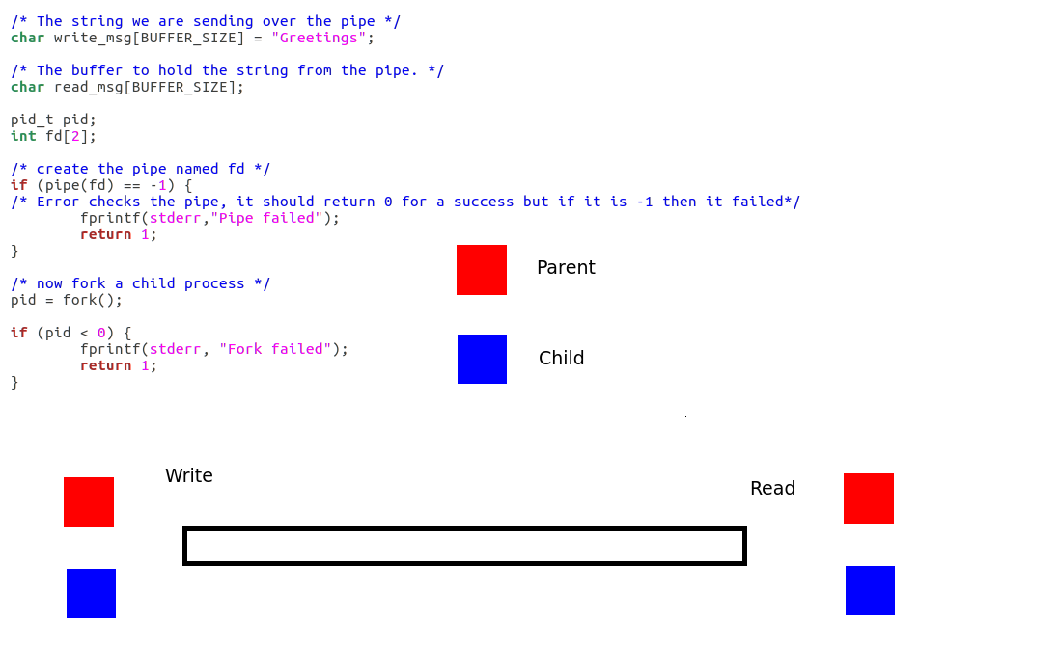
Pipe Usage

Slide 6
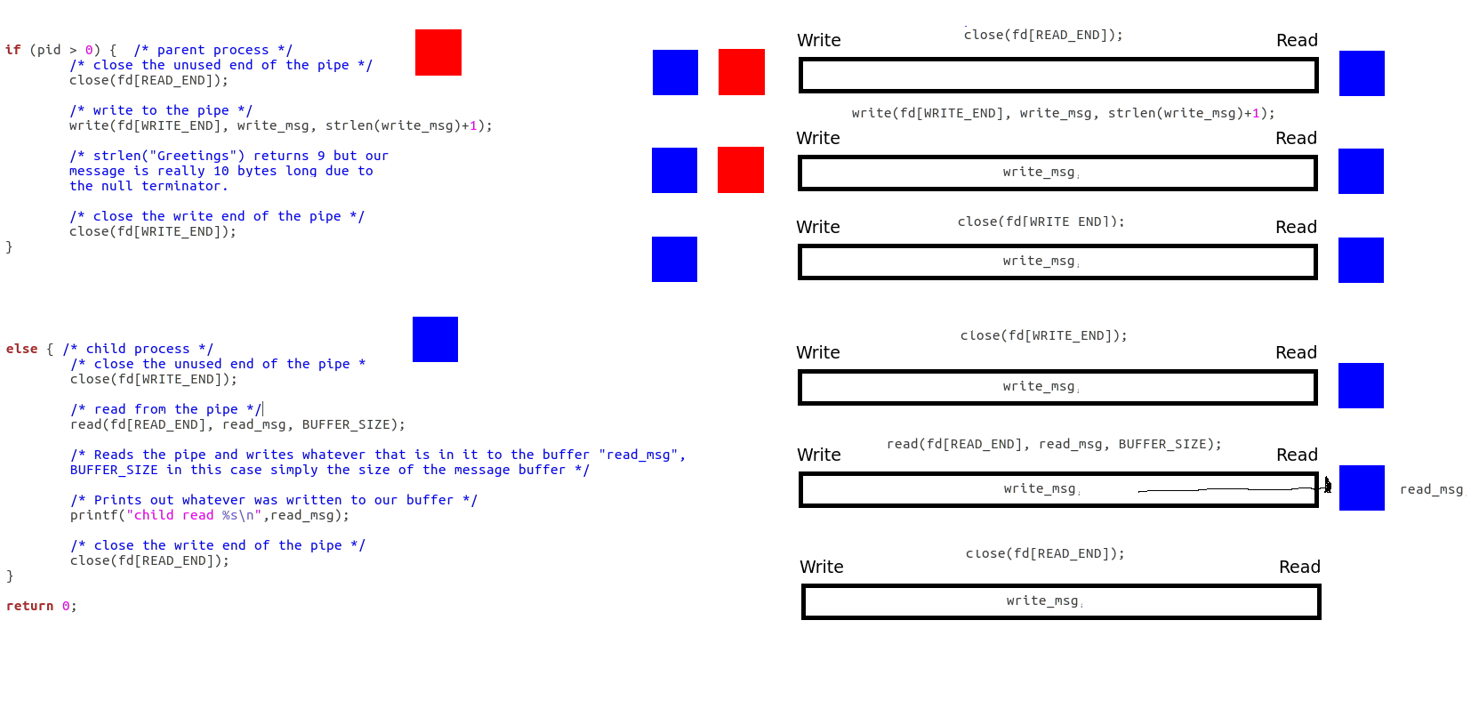
Pipe Usage

Slide 7
Sockets
Sockets allow processes at different nodes in a network to communicate
Two sides to sockets, the server and the client.
The Server creates a socket and binds it to the port it wants to listen from
The Client creates a socket and can try to connect it to that port via its address
The Server listens and can choose to accept client connections at the port
Once the Server accepts the client and server can send and receive messages across the network
Any node can be a client and any node can be a server. The client is the process that requests to connect and the server is the process that waits for a connection

Slide 8
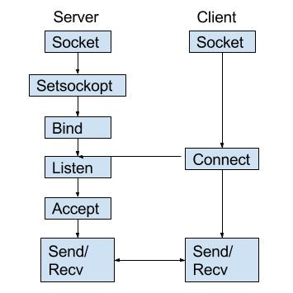
The Client-Server Model

Slide 9
Socket Methods for the Server process
int sockfd = socket(domain, type, protocol)
Sockfd is a variable that just holds the socket’s “file handle”
Domain refers to communication domain, for this field use either AF_INET or AF_INET6
Type is the communication type, for TCP use SOCK_STREAM
For internet protocol the protocol value is 0.
int bind( int sockfd, const struct sockaddr *addr, socklen_t addrlen)
Use structs to hold the port and address binded to (more on this in a second)
int listen(int sockfd, int backlog)
Backlog is the number of connections that can wait
int newsockfd =accept(int sockfd, struct sockaddr *addr, socklen_t *addrlen)
Pops the first pending connection from the listening socket and makes a new socket that is connected

Slide 10
Socket Methods for the Client process
int sockfd = socket(domain, type, protocol)
Exactly the same as the creation method for the server process
int connect(int sockfd, const struct sockaddr *addr, socklen_t addrlen)
Similar to the bind method for the server process however the difference is we don’t automatically bind the client to the port, instead we ask to connect and wait until accepted.
Note: with the server a new socket is created because the original socket it creates is only for listening. The client, however, communicates with the socket it connects with.

Slide 11
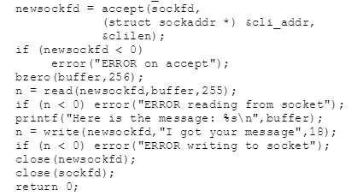
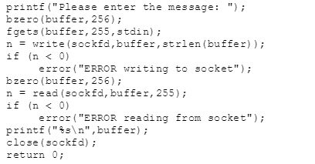
Reading and Writing Messages
From the Server
From the Client

Slide 12
Things to Note about Reading and Writing
bzero(void *sPtr, size_t n)
Clears n bytes of memory at the location sPtr points to
Ensures that when reading and writing messages we do not run into any our of memory exceptions
close(int fd)
Closes sockets after program closes
A program can only open so many socket, if you don’t close sockets on close eventually you will have leaks and the program will fail.
read(int fd, void *b, size_t n)
Takes the socket descriptor, a pointer to where the read bytes should be stored, and how much memory the bytes will take
write(int fd, void *b, size_t n)
Same parameters as reading but describes the bytes being written
Both reading/writing to a socket will return the number of bytes read/written or -1 on failure

Slide 13
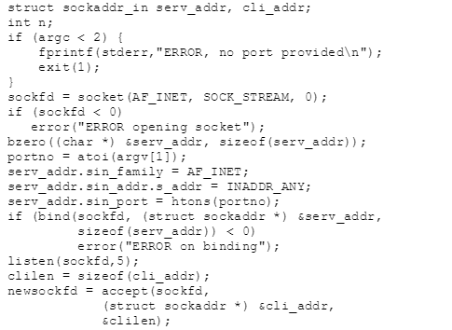
About that Struct Earlier (Server Process)
Sockaddr_in is a type of struct that holds address information for a socket.
Sin_family holds the domain
Port is the port number the socket will be bound to
S_addr is the IP address
Important to note that when the new socket is formed with a connected client it takes the client address struct in the accept() function

Slide 14
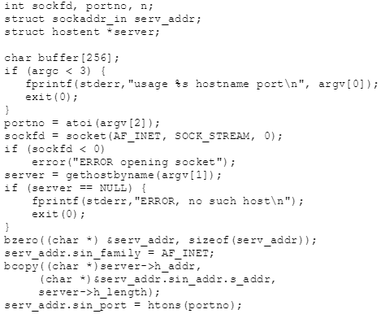
About that Struct Earlier (Client Process)
Sockaddr_in struct works the same for clients as servers
Uses an additional hostent struct to get and store the address of the server
Note: in order for a client to request a connection it needs to know where it is connecting that is why you need this additional struct

Slide 15
Additional Resources on Sockets
http://www.linuxhowtos.org/C_C++/socket.htm
http://www.informit.com/articles/article.aspx?p=169505&seqNum=2
https://www.gta.ufrj.br/ensino/eel878/sockets/sockaddr_inman.html
http://man7.org/linux/man-pages/man2/socket.2.html
http://man7.org/linux/man-pages/man2/bind.2.html
http://man7.org/linux/man-pages/man2/listen.2.html
http://man7.org/linux/man-pages/man2/accept.2.html
http://man7.org/linux/man-pages/man2/connect.2.html
http://man7.org/linux/man-pages/man2/read.2.html
http://man7.org/linux/man-pages/man2/write.2.html

